Slide 1
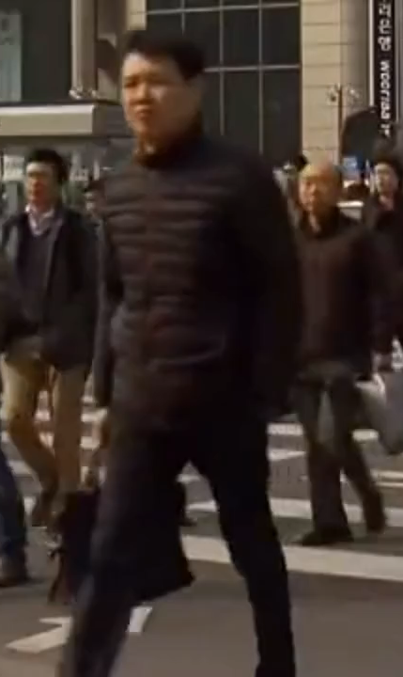
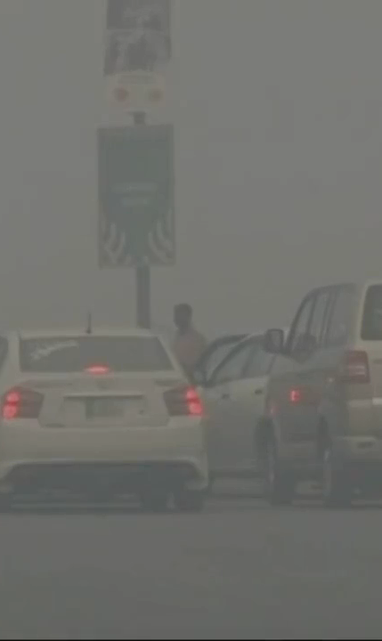
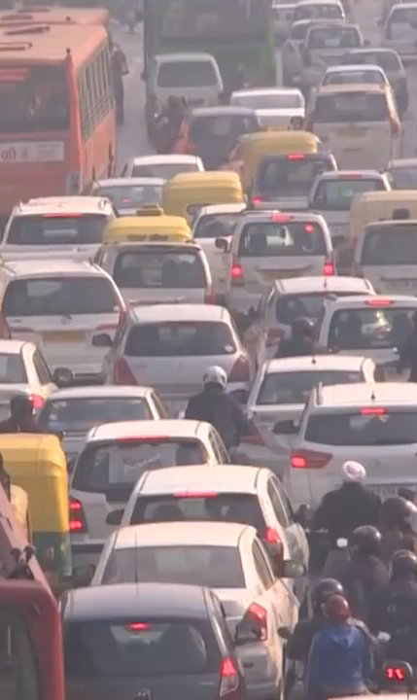
لاہور
LAHORE
서울
SEOUL
दिल्ली
DELHI

Slide 2
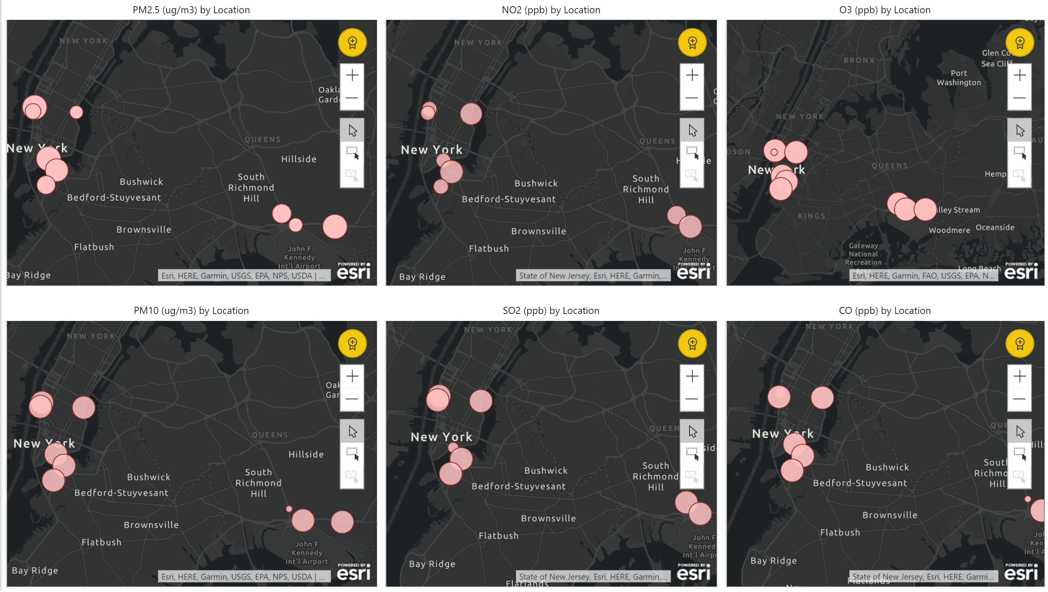
Datasets used – Breezometer Live Air Quality + NYC Live Traffic

Slide 3
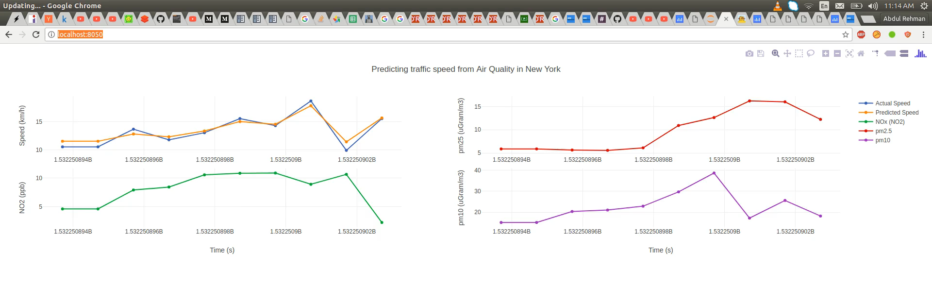
PREDICTING SPEED/ TRAFFIC CONGESTION FROM AIR QUALITY
https://119dfb93.ngrok.io

Slide 4





Salient Features & Future…
SUPERPOWERS
Promoting Public health awareness
Predicting traffic congestion using air quality
Smart Cities - Tool for regulators, city planners, & health care providers
Improving quality of life
Data transparen-cy

